Slide 1
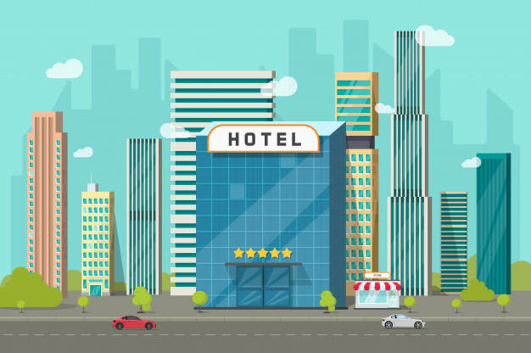

Hotel Recommender System and Sentiment Analysis of Customer Reviews
Mahapara Gayasuddin
PRESENTED BY:
MAHAPARA GAYASUDDIN
MENTOR:
KRISHNA KUMAR TIWARI
Hotel Recommender System and Sentiment Analysis of Customer Reviews

Slide 2
Agenda
Introduction
Problem Statement
Approach Layout
Business Understanding
Data Understanding
Data Preparation
Modelling
Model Evaluation
Result and Conclusion
Future Work
References

Slide 3
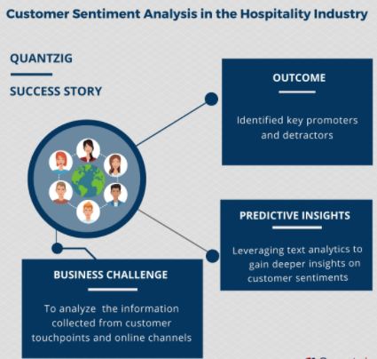
INTRODUCTION
SENTIMENT ANALYSIS IN HOTEL INDUSTRY
A major benefit of using Sentiment analysis in the hotel is that you can monitor the buzz on social media — who is saying what and what the buzz is all about.
Another prime benefit of using Sentiment analysis is the capability of analyzing and identifying critical issues in real-time. For example, if a ‘not so happy guest’ is about to churn, you can immediately identify the situation and find a way to solve it and take action right away.
Analyze Customer reviews about the hotel and discover if guests are happy about their hotel experience.
Hotels must be already doing a lot to improve staff performance, but the improvement process could get simply better and effective if hotels start to know where the staff lacked from its guests.
If the hotel is receiving a lot of negative reviews, you might want to know exactly what the issue is.
06/03/2021

Slide 4
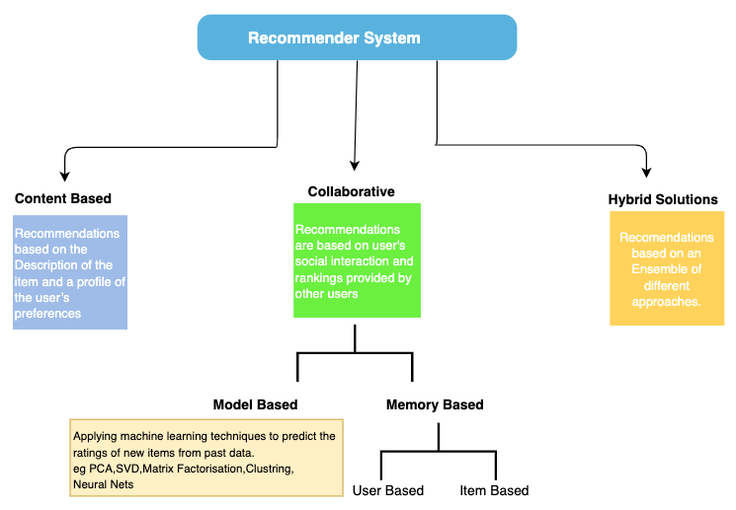
CONT…
RECOMMENDER SYSTEM IN HOTEL INDUSTRY
A recommendation system is an extensive class of web applications that involves predicting the user responses to the options.
Booking a hotel online can be an overwhelming task with thousands of hotels to choose from, for every destination. Motivated by the importance of these situations, we decided to work on the task of recommending hotels to users.
A recommendation system uses data analysis techniques to work out the items that match the users' taste & preferences
Recommendations typically speed up searches and make it easier for users to access the content they’re interested in and surprise them with offers they might haven’t looked for.
Giving good recommendations can help users spend less time looking for hotels of their kind. This, in turn, will allow the service to continue and offer a better experience.
06/03/2021

Slide 5
COLLABORATIVE FILTERING (CF)
Pure CF Approaches
Input – Only a matrix of given user–item ratings..
Output types – A (numerical) prediction indicating to what degree the current user will like or dislike a certain item – A top‐N list of recommended items.
The most prominent approach to generate recommendations
– used by large, commercial e‐commerce sites
– well‐understood, various algorithms and variations exist – applicable in many domains (book, movies, DVDs, ..)
Approach
– use the "wisdom of the crowd" to recommend items
Basic assumption and idea
– Users give ratings to catalog items (implicitly or explicitly) – Customers who had similar tastes in the past, will have similar tastes in the future.
06/03/2021
Hotel Recommender System and Sentiment Analysis of Customer Reviews

Slide 6
Restricted Boltzmann Machine
RBMs have the capability to learn latent factors/variables (variables that are not available directly but can be inferred from the available variables) from the input data.
RBMs are unsupervised learning algorithms that have the capability to reconstruct input approximations from the data. They do this by trying to produce the probability distribution of the input data with a good approximation which helps in obtaining data points which did not previously exist in our data.
They do this by learning a lower-dimensional representation of our data and later try to reconstruct the input using this representation.
Hotel Recommender System and Sentiment Analysis of Customer Reviews

Slide 7
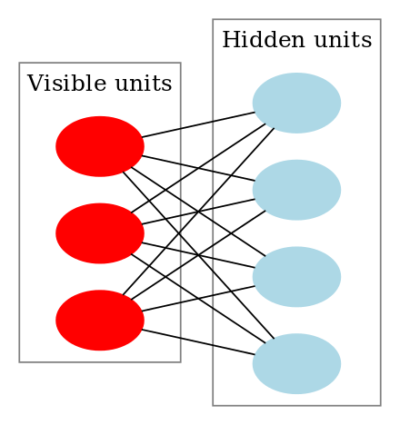
Continue….
They are a two-layered neural network (one being the visible layer and the other one being the hidden layer) and these two layers are connected by a fully bipartite graph.
This means that every node in the visible layer is connected to every node in the hidden layer but no two nodes in the same group are connected to each other.
This restriction allows for more efficient training algorithms than what is available for the general class of Boltzmann machines.
Diagram of a restricted Boltzmann machine with three visible units and four hidden units (no bias units).
06/03/2021
Hotel Recommender System and Sentiment Analysis of Customer Reviews

Slide 8
Problem Statement
To Build a Hotel recommendation engine and perform sentiment analysis of customer Reviews during the course of their stay
The hotel dataset for different hotels is going to be considered in this project. To perform the sentiment analysis, the feedback and ratings provided by the user to different hotels as well as reviews on the user's experience during the stay will be considered. The main objective of this project is to build a model for the prediction of user rating, the usefulness of the review and the most similar recommendation.
To conduct the sentiment analysis of customer feedback using different machine learning techniques .
To work with various collaborative filtering (CF) techniques to evaluate the relationship between users and hotel interdependencies to find new connections between user products. The majority of “CF” models are based on the user-item rating matrix in which a user is represented by each row, each column an item. The entries of this matrix are ratings given by users to items. So, for hotel recommendation various models have been developed i.e. Popularity based recommendation, Simple Recommendation, Item-Item Collaborative Filtering, MF based algorithm, ALS and RBM to recommend users the appropriate hotels.
Hotel Recommender System and Sentiment Analysis of Customer Reviews

Slide 9
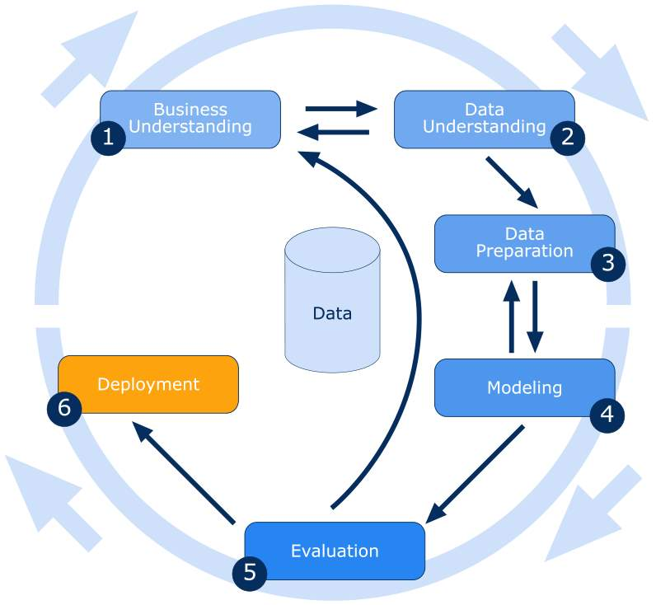
Approach Layout
Collecting data and applying data wrangling methods.
Starting exploratory data analysis to find trends and storytelling.
Conduct further data analysis to identify relationships between different variables.
Perform in-depth Sentiment analysis of the Reviews provided by the Customers for their stay in the hotel using different machine learning technique.
Perform in-depth analysis using collaborative filtering and machine learning techniques to recommend and predict.
06/03/2021
Hotel Recommender System and Sentiment Analysis of Customer Reviews

Slide 10
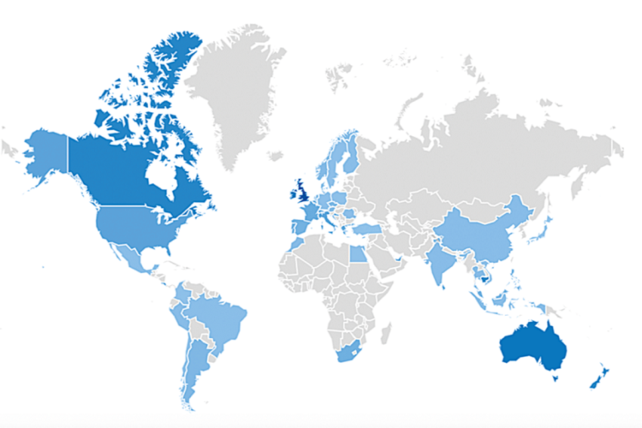
Business Understanding
TripAdvisor is the most successful online forum in the travel and tourism industry. Easily the world’s largest travel community, it reaches 390 million unique visitors each month and lists 465 million reviews and opinions about more than 7 million accommodations, restaurants, and attractions in 49 markets worldwide.
TripAdvisor has since been ranked as the most popular site for trip planning, with millions of tourists visiting the site when arranging their holidays
“Sentiment analysis” of customer and use of that information to study what people like and don’t like—and, more importantly why—helps develop better marketing campaign
Increased sales/conversion
Increased user satisfaction
Increased loyalty and share of mind
Reduced churn
35% of the purchases on Amazon are the result of their recommender system, according to McKinsey.
Recommendations are responsible for 70% of the time people spend watching videos on YouTube.
75% of what people are watching on Netflix comes from recommendations, according to McKinsey
Map of the popularity of TripAdvisor searches in Google over the last five years
06/03/2021
Hotel Recommender System and Sentiment Analysis of Customer Reviews

Slide 11
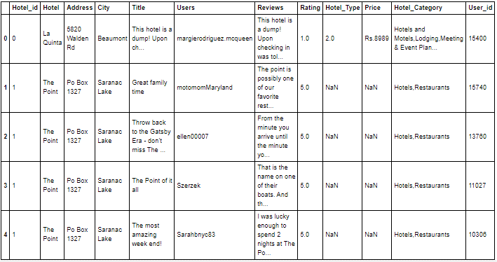
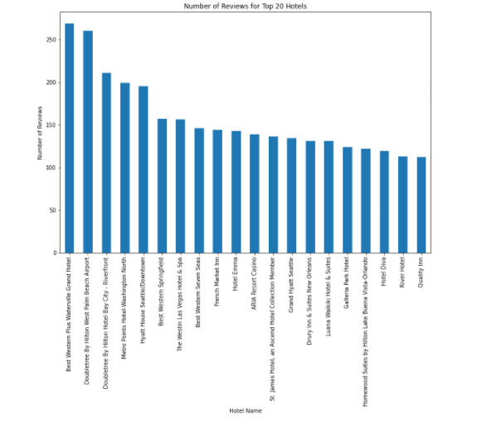
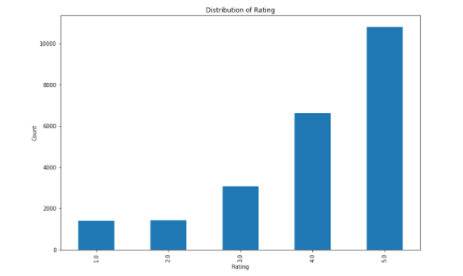
Data Understanding
Distribution of Rating
Top 20 Most Reviewed Hotels
06/03/2021
Hotel Recommender System and Sentiment Analysis of Customer Reviews

Slide 12
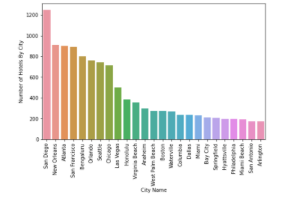
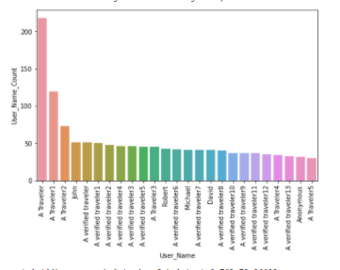
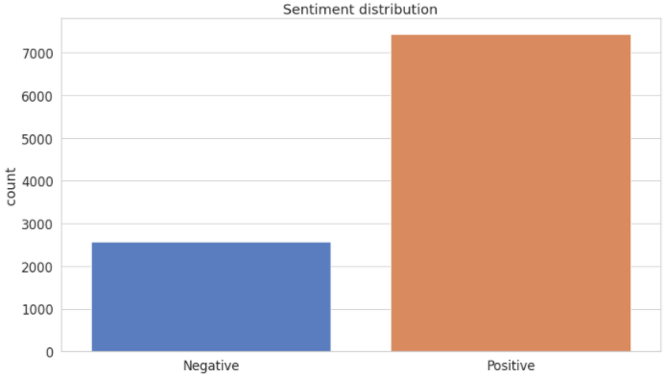
Continue….
Frequent user Name
Sentiment Distribution
Reviews Distribution by City
06/03/2021
Hotel Recommender System and Sentiment Analysis of Customer Reviews

Slide 13
Data Preparation
Hotel data Collection from various sites (Web scraping from TripAdvisor website and Datafiniti-Hotel-Reviews)
Cleaned the data for missing values that might be within the Hotel data. For numerical data, such as the ratings, averages based on user data were used.
Some of the hotel's details were missing when web scraped from the TripAdvisor website, so their information had to be entered manually
Then performed feature selection to remove unnecessary features such as “reviews. source URLs”,” sourceURLs “,” Websites”,” Postal code”,” reviews.date” and low variance features such as latitude, longitude
Dropped Duplicate Rows.
Merged the data collected from different sources into a single format for analysis
Hotel Recommender System and Sentiment Analysis of Customer Reviews

Slide 14
Modelling
Model Development
Text Mining Engine
TripAdvisor Data
Active User Ratings
Collaborative Filtering
Hotel Recommendations
User Rating Matrix
Text pre-processing
Training the sentiment classifier
User Ratings
Active User Ra
Normalizing feature vector
Hotel Dataset
Storing the trained model
Transforming text to feature vector
User’s Review
Sentiment analysis
Target Data
Polarity score
Recommender system
Sentiment Extraction and Analysis
Hotel Recommender System and Sentiment Analysis of Customer Reviews

Slide 15
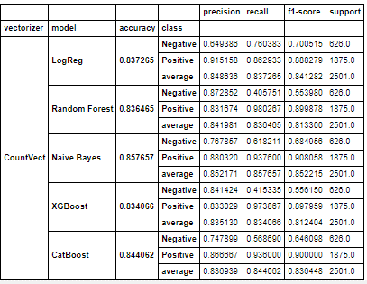
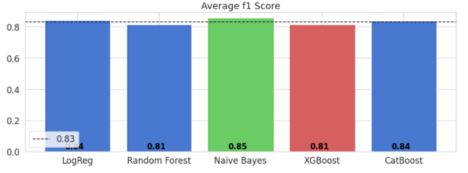
Model Evaluation
Comparison Matrix of Models using Count Vectorizer
Average F1 Score using Count Vectorizer
Hotel Recommender System and Sentiment Analysis of Customer Reviews

Slide 16
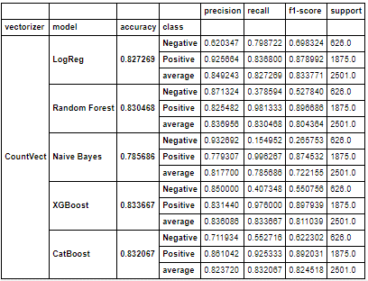
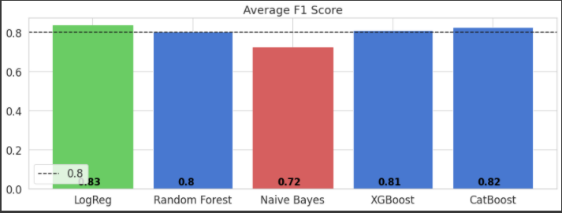
Continue….
Comparison Matrix of Models using TF-IDF Vectorizer
Average F1 Score using TF-IDF Vectorizer
Hotel Recommender System and Sentiment Analysis of Customer Reviews

Slide 17
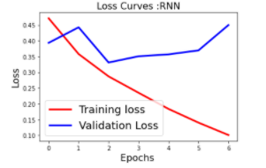
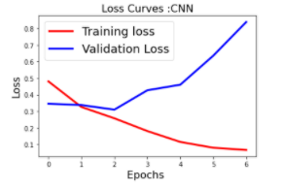
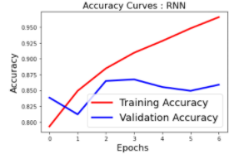
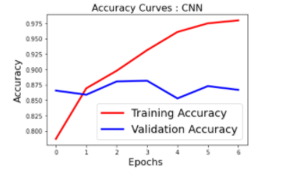
Continue….
RNN Model for sentiment classification:
CNN Model for sentiment classification:
06/03/2021
Hotel Recommender System and Sentiment Analysis of Customer Reviews

Slide 18
Continue….
Model Used | Accuracy Achieved
Logistic Regression using CV | 0.837625
Naïve Bayes using CV | 0.857657
Random Forest using CV | 0.836465
XGBoost using CV | 0.834066
CATBoost using CV | 0.844062
Logistic Regression using “TF-IDF” | 0.827269
Naïve Bayes using “TF-IDF” | 0.785686
Random Forest using “TF-IDF” | 0.830468
XGBoost using “TF-IDF” | 0.833667
CATBoost using “TF-IDF” | 0.832067
CNN | 0.8668
RNN | 0.8588
Factorization Machines (FM) | 0.893729
User_Id Hotel_Id | SVD | NMF | Slope One | KNN | CoClustering | Actual Rating
User_id=30 Hotel_id=96 | 4.28 | 4.89 | 5 | 4.99 | 5 | 5
User_id=3259 Hotel_id=25 | 4.10 | 3.68 | 3.60 | 4.17 | 2.09 | 4
User_id=13532 Hotel_id=9 | 4.05 | 3.93 | 4 | 4.01 | 4.17 | 4
Accuracy of the Models for Sentiment Analysis
The predicted rating of some samples with their actual values
Hotel Recommender System and Sentiment Analysis of Customer Reviews

Slide 19
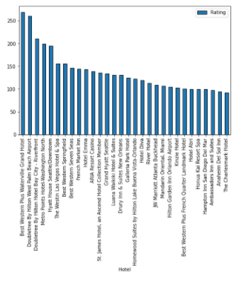
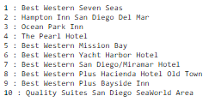
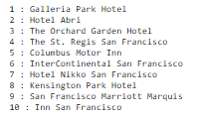
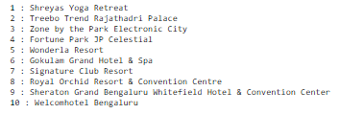
Hotel Recommender System
Recommendation based on Popularity:
Simple Recommendation:
Top 10 hotels to recommend in San-Diego
Top 10 hotels to recommend in San Francisco
Top 10 hotels to recommend in Bengaluru
Top Popular Hotels to Recommend to the Users
06/03/2021
Hotel Recommender System and Sentiment Analysis of Customer Reviews

Slide 20
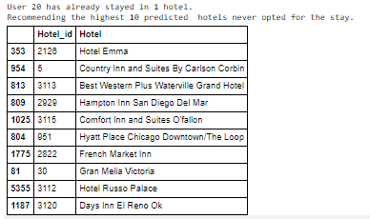
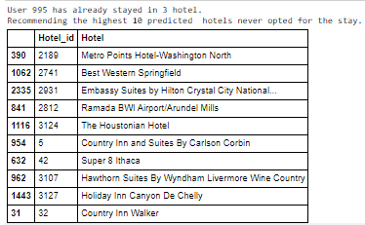
Continue….
Item-Item based Collaborative Filtering:
User 20 has already stayed in one hotel, so recommending the other ten hotels to him to stay at.
User 995 has already stayed in one hotel, so recommending the other ten hotels to him to stay at.
06/03/2021
Hotel Recommender System and Sentiment Analysis of Customer Reviews

Slide 21
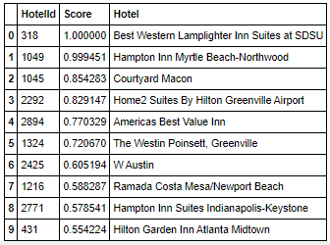
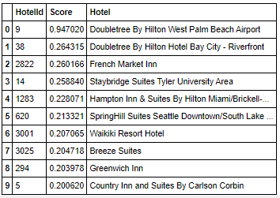
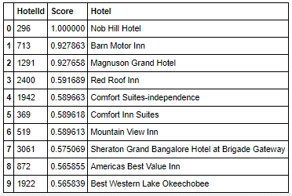
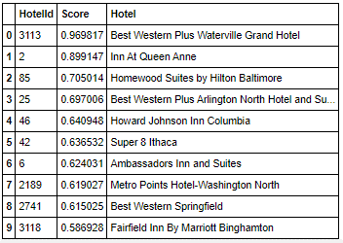
Continue….
Alternating Least Squares (ALS) Collaborative Filtering
Hotel Similar to the Best Western Lamplighter Inn Suites at SDSU (Hotel_id = 318)
Hotel recommendations for the user with id= 20
Hotel Similar to the Nob Hill Hotel (Hotel_id = 296)
Hotel recommendations for the user with id= 995
06/03/2021
Hotel Recommender System and Sentiment Analysis of Customer Reviews

Slide 22
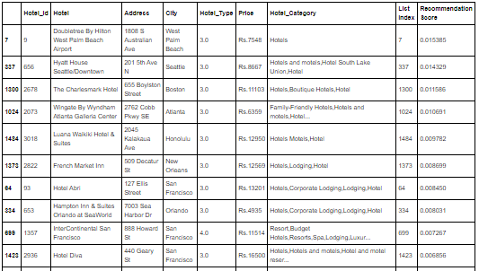
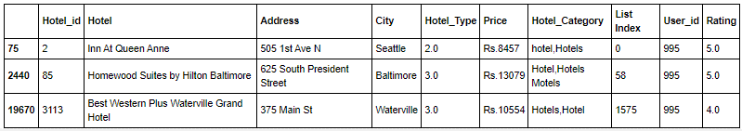
Continue….
The Restricted Boltzmann Machine model
10 Most Recommended Hotels for the Mock User (User_id=995)
List of hotels in which User_id=995 has already stayed
06/03/2021
Hotel Recommender System and Sentiment Analysis of Customer Reviews

Slide 23
Result and Conclusion
The sentiment analysis of the customer reviews has been done and it is seen that the factorization machine model has performed very well with the accuracy of 89.37%.
SVD and KNN provide the lowest RMSE.
Different recommender system models have been implemented to provide recommendations to the users. So, a user can get various new options while searching for a hotel which they were not aware of earlier.
06/03/2021
Hotel Recommender System and Sentiment Analysis of Customer Reviews

Slide 24
FUTURE WORK
In the future, the deployment should be done by Creating Web Pages and linking it to Flask Rendering and finally, deploying it to Herokuapp.com to get the top 10 hotels.
To implement other recommendation technique like Hybrid techniques
To combine A/B testing to the techniques used in this project to improve the result.
To integrate time into a recommendation method because there are sometimes seasonal effects of choice.
Hotel Recommender System and Sentiment Analysis of Customer Reviews

Slide 25
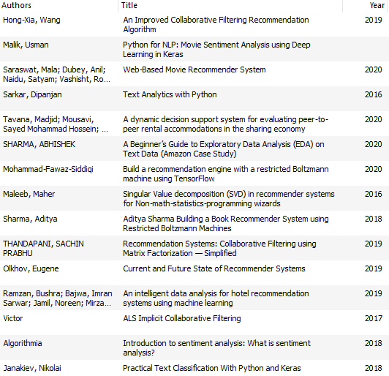
References
Hotel Recommender System and Sentiment Analysis of Customer Reviews

Slide 26

Hotel Recommender System and Sentiment Analysis of Customer Reviews

